Slide 1




Chapter 5: Support Vector Machines
MACHINE LEARNING

Slide 2
Introduction to SVMs
Definition:
SVMs are supervised learning models used for classification and regression tasks.
Key Idea:
Find the hyperplane that best separates classes in the feature space.
Applications:
Text classification, image recognition, bioinformatics.​
Notes:
When conducting research, it is easy to go to one source: Wikipedia. However, you need to include a variety of sources in your research. Consider the following sources:
Who can I interview to get more information on the topic?
Is the topic current and will it be relevant to my audience?
What articles, blogs, and magazines may have something related to my topic?
Is there a YouTube video on the topic? If so, what is it about?
What images can I find related to the topic?

Slide 3
Linear SVM Classification
Use Case: When data is linearly separable.
Function: Finds a straight-line (or hyperplane in higher dimensions) to separate classes.
Example: Binary classification with clearly separable classes.
Notes:
When conducting research, it is easy to go to one source: Wikipedia. However, you need to include a variety of sources in your research. Consider the following sources:
Who can I interview to get more information on the topic?
Is the topic current and will it be relevant to my audience?
What articles, blogs, and magazines may have something related to my topic?
Is there a YouTube video on the topic? If so, what is it about?
What images can I find related to the topic?

Slide 4
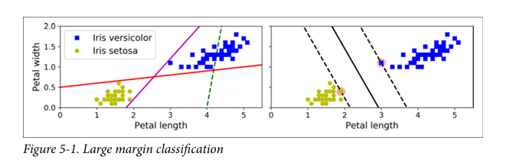
Visualizing Linear Classification
Three Classifiers on Iris Dataset:
Thin Solid Line Classifiers: Correct, but margins are narrow → may not generalize well.
Dashed Line Classifier: Incorrect – fails to separate the classes.
Bold Solid Line (SVM): Maximizes margin → better generalization.
Large Margin Classification: SVM chooses the hyperplane that leaves the widest margin between the two classes.
Notes:
When conducting research, it is easy to go to one source: Wikipedia. However, you need to include a variety of sources in your research. Consider the following sources:
Who can I interview to get more information on the topic?
Is the topic current and will it be relevant to my audience?
What articles, blogs, and magazines may have something related to my topic?
Is there a YouTube video on the topic? If so, what is it about?
What images can I find related to the topic?

Slide 5
Visualizing Linear Classification
Support Vectors:
Data points lying directly on the edges of the margin (the dashed lines).
Key Property: These are the only data points that influence the decision boundary.
Effect of More Data: Adding instances away from the street does not affect the SVM boundary.
Notes:
When conducting research, it is easy to go to one source: Wikipedia. However, you need to include a variety of sources in your research. Consider the following sources:
Who can I interview to get more information on the topic?
Is the topic current and will it be relevant to my audience?
What articles, blogs, and magazines may have something related to my topic?
Is there a YouTube video on the topic? If so, what is it about?
What images can I find related to the topic?

Slide 6
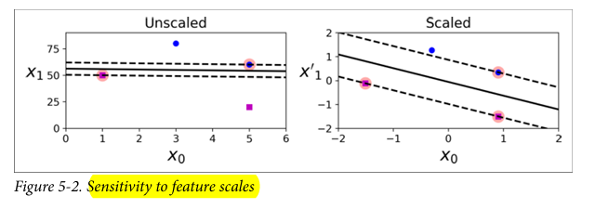
Sensitivity to Feature Scales
Left Plot:
Features have different scales → SVM creates a skewed decision boundary.
Vertical axis dominates due to larger scale.
Right Plot (After Feature Scaling):
Proper scaling (e.g., using StandardScaler) results in a balanced and accurate decision boundary.
So Always apply feature scaling (e.g., standardization) before training an SVM model.
Notes:
When conducting research, it is easy to go to one source: Wikipedia. However, you need to include a variety of sources in your research. Consider the following sources:
Who can I interview to get more information on the topic?
Is the topic current and will it be relevant to my audience?
What articles, blogs, and magazines may have something related to my topic?
Is there a YouTube video on the topic? If so, what is it about?
What images can I find related to the topic?

Slide 7

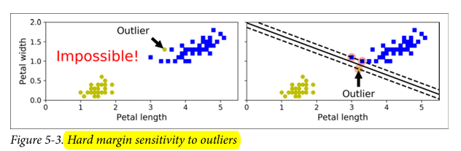
Soft Margin Classification
Hard Margin Issues:
Requires perfectly linearly separable data
Extremely sensitive to outliers
One outlier can destroy the decision boundary
Notes:
Once you find your sources, you will want to evaluate your sources using the following questions:
Author:
Who is the author?
Why should I believe what he or she has to say on the topic?
Is the author seen as an expert on the topic? How do you know?
Current:
How current is the information in the source?
When was the source published?
Is the information out-of-date?
Accuracy:
Is the content accurate?
Is the information presented objectively? Do they share the pros and cons?

Slide 8
Visualizing the Problem
❌No possible boundary due to outlier
❌ Bad decision boundary due to forced separation
Takeaway:
Hard Margin = Overly rigid
Soft Margin = Flexible, better for real-world data
Notes:
Once you find your sources, you will want to evaluate your sources using the following questions:
Author:
Who is the author?
Why should I believe what he or she has to say on the topic?
Is the author seen as an expert on the topic? How do you know?
Current:
How current is the information in the source?
When was the source published?
Is the information out-of-date?
Accuracy:
Is the content accurate?
Is the information presented objectively? Do they share the pros and cons?

Slide 9
Soft Margin Classification
Soft Margin Classification:
Allows some margin violations to improve generalization
Goal: Balance between wide margin and few violations
The Role of Hyperparameter C:
C controls trade-off between:
Margin size
Margin violations
Notes:
Once you find your sources, you will want to evaluate your sources using the following questions:
Author:
Who is the author?
Why should I believe what he or she has to say on the topic?
Is the author seen as an expert on the topic? How do you know?
Current:
How current is the information in the source?
When was the source published?
Is the information out-of-date?
Accuracy:
Is the content accurate?
Is the information presented objectively? Do they share the pros and cons?

Slide 10
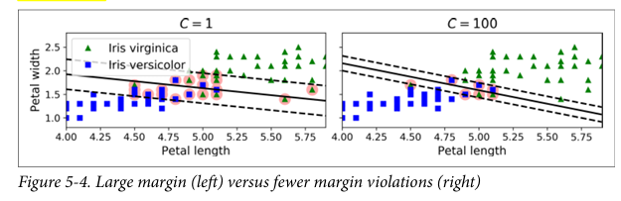
Role of Hyperparameter C
Low C:
More violations allowed
Wider margin → Better generalization
High C:
Fewer violations
Narrower margin → Higher risk of overfitting
Reduce C to regularize an overfitting SVM
Notes:
Once you find your sources, you will want to evaluate your sources using the following questions:
Author:
Who is the author?
Why should I believe what he or she has to say on the topic?
Is the author seen as an expert on the topic? How do you know?
Current:
How current is the information in the source?
When was the source published?
Is the information out-of-date?
Accuracy:
Is the content accurate?
Is the information presented objectively? Do they share the pros and cons?

Slide 11
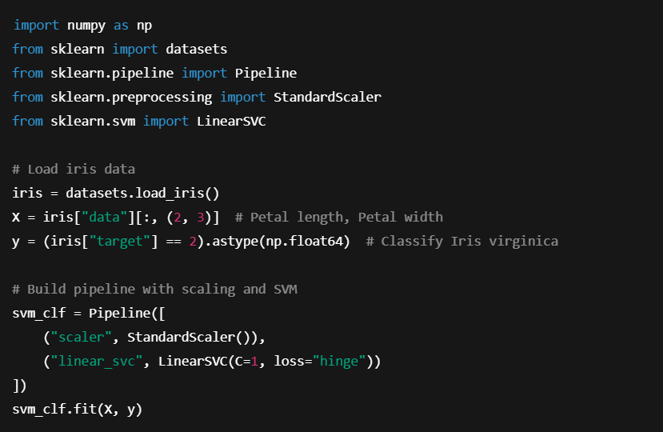
Code Example:
Note: SVM classifiers do not output probabilities
Use decision_function() to get distance from decision boundary.
Notes:
Once you find your sources, you will want to evaluate your sources using the following questions:
Author:
Who is the author?
Why should I believe what he or she has to say on the topic?
Is the author seen as an expert on the topic? How do you know?
Current:
How current is the information in the source?
When was the source published?
Is the information out-of-date?
Accuracy:
Is the content accurate?
Is the information presented objectively? Do they share the pros and cons?

Slide 12
Alternative SVM Implementations
Classifier | Notes
LinearSVC | Fast, recommended for large datasets
SVC(kernel="linear") | Slower, but supports probability outputs with probability=True
SGDClassifier | Good for online learning or huge datasets
Notes:
Once you find your sources, you will want to evaluate your sources using the following questions:
Author:
Who is the author?
Why should I believe what he or she has to say on the topic?
Is the author seen as an expert on the topic? How do you know?
Current:
How current is the information in the source?
When was the source published?
Is the information out-of-date?
Accuracy:
Is the content accurate?
Is the information presented objectively? Do they share the pros and cons?

Slide 13
Practical Tips & Reminders
✅ Use StandardScaler to center and scale data
✅ Set loss="hinge" in LinearSVC
✅ Set dual=False if features > training examples
✅ Tune C for regularization and margin control
Notes:
Once you find your sources, you will want to evaluate your sources using the following questions:
Author:
Who is the author?
Why should I believe what he or she has to say on the topic?
Is the author seen as an expert on the topic? How do you know?
Current:
How current is the information in the source?
When was the source published?
Is the information out-of-date?
Accuracy:
Is the content accurate?
Is the information presented objectively? Do they share the pros and cons?

Slide 14
Nonlinear SVM Classification
Many real-world datasets are not linearly separable.
Linear SVMs struggle with complex data distributions.
We need a way to transform data for linear separation.
Notes:
After consulting a variety of sources, you will need to narrow your topic. For example, the topic of internet safety is huge, but you could narrow that topic to include internet safety in regards to social media apps that teenagers are using heavily. A topic like that is more specific and will be relevant to your peers. Some questions to think about to help you narrow your topic:
What topics of the research interest me the most?
What topics of the research will interest my audience the most?
What topics will the audience find more engaging? Shocking? Inspiring?

Slide 15
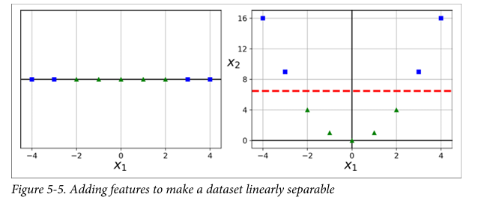
Nonlinear SVM Classification
Left: it represents a simple dataset with just one feature, x1 . This dataset is not linearly separable
Right: if you add a second feature x2 = (x1 )2, the resulting 2D dataset is perfectly linearly separable
Notes:
After consulting a variety of sources, you will need to narrow your topic. For example, the topic of internet safety is huge, but you could narrow that topic to include internet safety in regards to social media apps that teenagers are using heavily. A topic like that is more specific and will be relevant to your peers. Some questions to think about to help you narrow your topic:
What topics of the research interest me the most?
What topics of the research will interest my audience the most?
What topics will the audience find more engaging? Shocking? Inspiring?

Slide 16
Nonlinear SVM Classification
Left: it represents a simple dataset with just one feature, x1 . This dataset is not linearly separable
Right: if you add a second feature x2 = (x1 )2, the resulting 2D dataset is perfectly linearly separable
Notes:
After consulting a variety of sources, you will need to narrow your topic. For example, the topic of internet safety is huge, but you could narrow that topic to include internet safety in regards to social media apps that teenagers are using heavily. A topic like that is more specific and will be relevant to your peers. Some questions to think about to help you narrow your topic:
What topics of the research interest me the most?
What topics of the research will interest my audience the most?
What topics will the audience find more engaging? Shocking? Inspiring?

Slide 17
Organize Your Research
Refer to the notes section below for guidelines on this topic.
Notes:
Now, that you have narrowed your topic, you will want to organize your research in a structure that works. There are some common organizational patterns based on the kind of research you are doing.
Organizational Structures:
Cause and Effect- this kind of structure is great for explaining the causes and effects of a topic
Compare and Contrast- in this pattern you highlight the similarities and differences of the topic
Explain process- this structure is great for outlining a series of steps to follow;
Definition- if you want to make sure your audience understands what something is using illustrations, meanings, clarifying misconceptions, you may want to use this structure
Classification- a common organizational structure is grouping like topics or facts from the research together. For instance, in the internet safety about social media apps, you may organize the research where you look at each social media app one at a time

Slide 18
Present Your Research
Refer to the notes section below for guidelines on this topic.
Notes:
After you’ve done your research, it’s time to put your presentation together. The first step in the process is to introduce the topic. This is a great time to connect your topic to something that your audience can relate. In other words, why should they listen to all the information you will be sharing in your research presentation? What is in it for them? You may also want to include a graphic or image to grab their attention.
Feel free to duplicate this slide by right-clicking on this slide in the slides pane to the left and select Duplicate Slide.
The next step in your presentation is to state your claim or topic clearly. Your teacher may even call this your thesis. As you state your thesis, you may find that this layout is not the best layout for your claim or topic. You can change the layout by clicking the drop-down menu next to the Layout in the Slides menu section. You can choose Two Content, Comparison, or Picture with Caption. Note: A different layout might change the look of the icons on this page.
You will also want to state your facts. You have done the research now share some of the interesting facts with your audience. Facts do not have to be boring; you can communicate facts in a variety of ways by going to the Insert Tab. In the Insert tab you can:
Insert pictures from your computer or online.
Add a chart
Create some SmartArt
Insert a variety of icons to help your facts come to life. Note: You can change the color of the icons by selecting the icon and then click on the Format tab and then Graphics Fill. From there, you will choose a color from the list or choose More Fill Colors to give you more options.
Since this research presentation is a result of your hard work and searching, you want to make sure you support the claims or points in your presentation with facts from your research findings. Make sure you give the author proper credit for helping you share your ideas. If one of your sources has a video that is relevant to your topic, you can add the video as added support. Keep in mind the length of the video and the amount of time you have for your presentation. For a 5 minute speech, the video should be no longer than 30 seconds.
Questions to consider:
How will you state the author of the source?
Will you need to cite the source on the slide?
What are some ways you can engage your audience so they feel like they are a part of the presentation? Some ideas to consider is by taking a quick poll like: by a show of hands, how many of you think school uniforms are a way to cut down on bullying? Another suggestion is to have them hold up a certain number of fingers to see if they agree or disagree. Finally, you can share a story that the audience can relate to that makes them laugh.
After all the applause, your audience may have some questions. Be prepared to answer some of their questions by making a list of questions you think they might ask. You may also want to share the presentation with them by providing the link to your presentation, if they want more information.

Slide 19
Research Presentation End
Notes:
You can use this slide as your opening or closing slide. Should you choose to use it as a closing, make sure you review the main points of your presentation. One creative way to do that is by adding animations to the various graphics on a slide. This slide has 4 different graphics, and, when you view the slideshow, you will see that you can click to reveal the next graphic. Similarly, as you review the main topics in your presentation, you may want each point to show up when you are addressing that topic.
Add animation to images and graphics:
Select your image or graphic.
Click on the Animations tab.
Choose from the options. The animation for this slide is “Split”. The drop-down menu in the Animation section gives even more animations you can use.
If you have multiple graphics or images, you will see a number appear next to it that notes the order of the animations.
Note: You will want to choose the animations carefully. You do not want to make your audience dizzy from your presentation.

